Slide 1
Parking Lot Automation
Members:
Mahavir lunkad 19BCE1774 Arnab Karmakar 19BAI1090 T Sri Siddhartha 19BCE1351

Slide 2
Abstract
In the current scenario of parking management system, optimal usage of parking space and the abruptness to park vehicles are critical factors. Technology based Parking Management System is an automated and advanced solution that provides management of vehicles right from an entry in the parking area to the exit. Optimizing the parking space for vehicles is still a problematic area for businesses, Government offices, various public places as well as municipalities authorities in multiple cities across India. Our Parking Management System offers a productive implementation of the parking resources.

Slide 3
Objectives
The aim of implementing Parking Management System is to reduce time and increase efficiency of the current Parking Management System. In overpopulated cosmopolitan zones, parking strategies must be well implemented for management of vehicles. The system provides details of the vacant parking slots in the vicinity and reduces the traffic issues due to illegal parking in the vicinity. It is designed with an objective to meet the requirements of controlled parking that offers effortless parking tactics to the authorities.
The system aims to provide an mobile application which manages the parking system for the user autonomously. The app aims to provide a interactive and user friendly UI/UX to display the available parking slots and enable seamless payments.
The entire process of entering and exiting the parking lot is managed by the app from logging in timestamps and fine detection.

Slide 4
Keywords
Smart parking system
CNN train
SVM train
Image processing
Smartphone application
Web application
Machine learning

Slide 5
Modules
UI visualization for the slots in the lot
User QR code generation
QR code and number plate recognition and database communication
Bill calculation and generation
Find nearest slot available in the particular level/floor

Slide 6
Societal Impact
Reduces impact on historic areas and buildings – smaller footprint and discrete access
Increases personal safety at night
Reduces accidents and car damage
Minimizes theft
Increases safety for pedestrians and cyclists
Reduces noise impact and pollution, acoustic and vibrational impacts
Provides options such as storage pods or provision for cyclists’ bike storage
Provides accessible parking for all users including disabled and parents with children
Provides convenience through intelligent software that allows for scheduled vehicle retrieval and optimized waiting times
Saves users the time of having to drive through a garage to find a space, park and walk out

Slide 7
Scope
This developed technology can be used in any urban areas where the car parking is most. Some of the heavy traffic places where this project can be installed and used are mentioned here:
Shopping Malls
Hospitals
Airports
Cinema Hall

Slide 8
Literature Survey
Versionx:
An integrated smart parking system to automate end-to-end parking processes.It is integrated with visitor management system, FASTag, and access control hardware. Extremely useful for shared parking spaces, the solution automates
day-to-day processes such as auto-identifying appropriate parking slots - be it reserved or pay-and-park, auto-generating
parking tickets, levying penalties, and many more.
Mantra:
On-Street Parking Control System: Parking management system offers innovative parking solutions that utilize cutting-edge technology for on-street parking system.
In today’s world parking lots have become redundant and needs lot of manpower to handle and maintain it. These parking lots are not user friendly and do not provide data regarding availability of free spaces. Many researchers have contributed to this issue and formalized with various methods to better optimize the parking lot to serve the needs. The author proposed smart parking reservation system using short message services (SMS), for that he uses Global System for Mobile(GSM) with microcontroller to enhances security. The ZigBee technique is used along with the GSM module for parking management and reservation. The author uses Global Positioning System(GPS) and Android platform to show available parking spaces. However, reservation for the same is not available.

Slide 9
PARKING ISSUE IN INDIA
A. Need for Cleaning System
The biggest issue with owning a car in a metropolitan city in India is finding a suitable parking space due to a lack of parking space. The number of
cars in India is more than 40 million, which corporations and personal individuals own. And the number is increasing day by day because of the
affordable prices of cars and the improvement of the economic status of a middle-class person. In recent time there has been an increase in the
number of vehicles, but the space for parking has not increased according to the requirements. As a result, around 40% of road space is utilized for
parking instead of transport activity. Which increases road accidents.
SOLUTION TO PARKING PROBLEMS
The parking problem can be eliminated by using various parking solutions in this paper; the various parking systems and their advantages &
limitations are discussed.
Modular or Puzzle Type
Puzzle-type automated multilevel parking is inspired by the children's game of '15-sliding puzzle'; a 4*4 grid has one empty slot. For parking or
removal of the car, shuffling of cars should be done to bring it to its desired location. Major components of this system are shelves/shuttles, a lift for
vertical movement in multilevel, AGVs, I/O points. Here shelves/shuttles can be either movable in X and Y direction or stationery. The major
drawback is the complicated management of the system. There are various proposed retrieval methods in movable shuttles, such as optimal dual
load retrieval and multiple load retrieval methods. Some shelf management strategies are autonomous shelf strategy and AGV powered shelf
management strategies.

Slide 10
Proposed Method
User Side
A mobile application where the user can login/register.
The user side application that stores the user info
A payment gateway in the app to enable online transactions
UPI based transactions GPAY PhonePay Paytm BHIM
Determine the nearest available parking slot and assign it to the user
Constantly checks the live feed for available parking slots
Visualize the Parking level with slots and its occupancy
Live feed that tracks the vacancy of the slots
Enable cashless transactions
Admin Side
Manage all the slots in the parking lot
Retrieve data from user QR code and send/get data to and from the database
A camera scanner that looks for a qr code and reads the userID from the qr code
Append the number plate registration data recognized using a camera module
Another camera module to scan the number plate for the regno
Calculate the cost and generate a bill
Store the time of entry and exit to calculate the bill

Slide 11
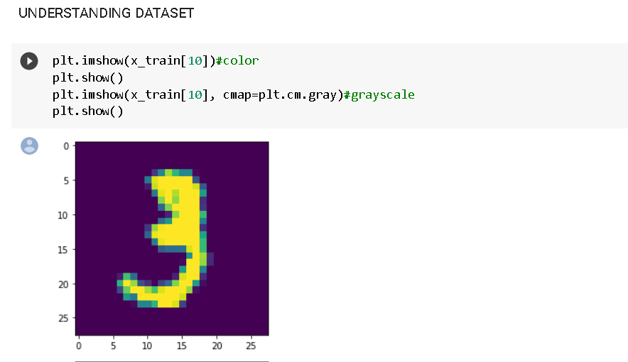
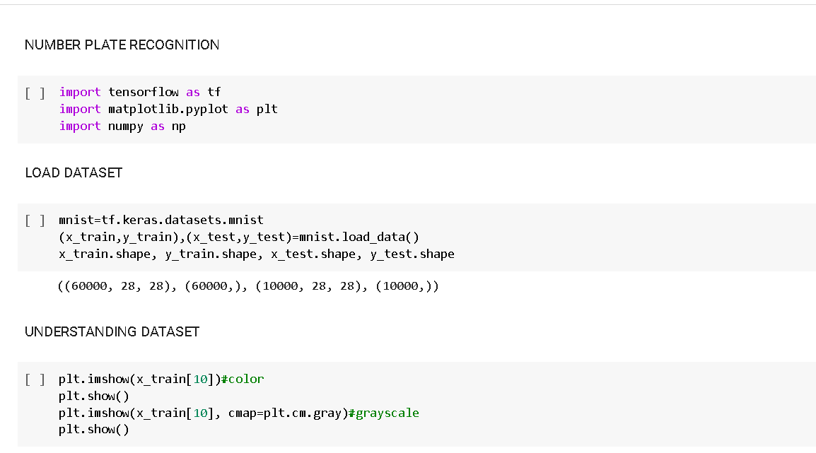
IMPLEMENTATION
NUMBER PLATE RECOGNITION

Slide 12
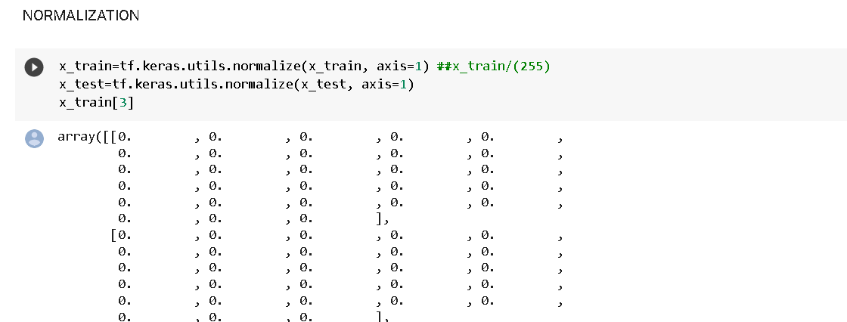
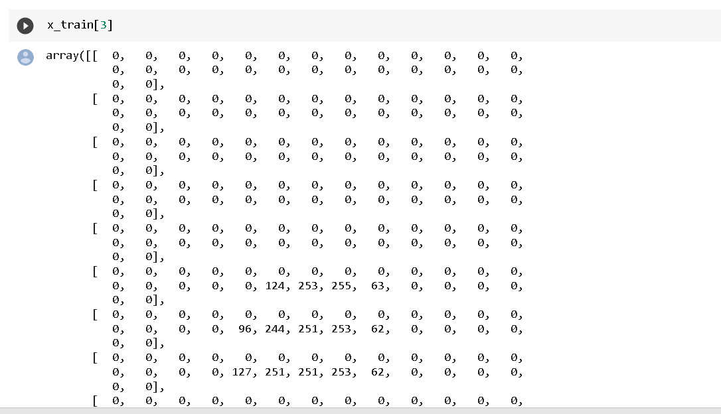

Slide 13
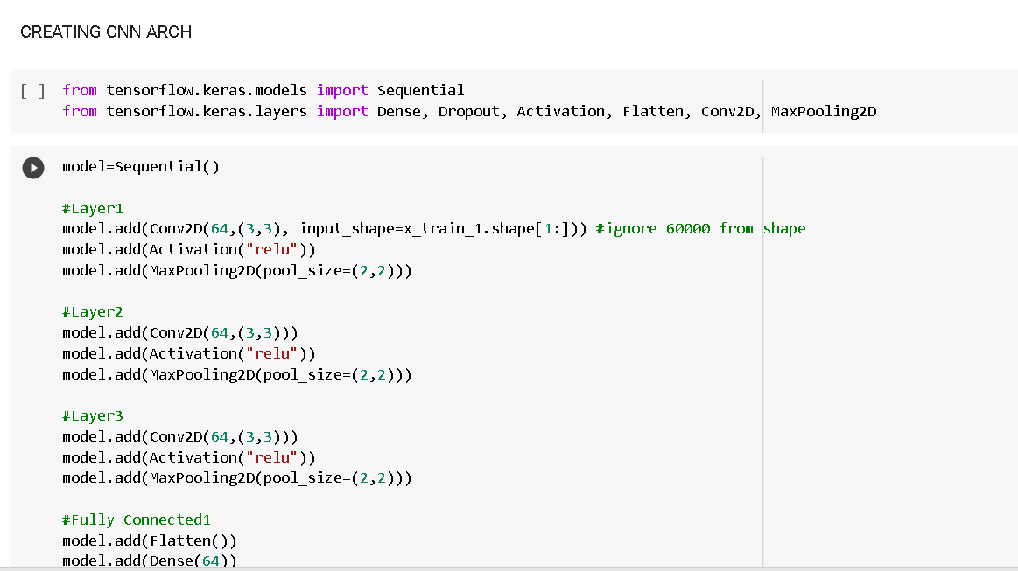
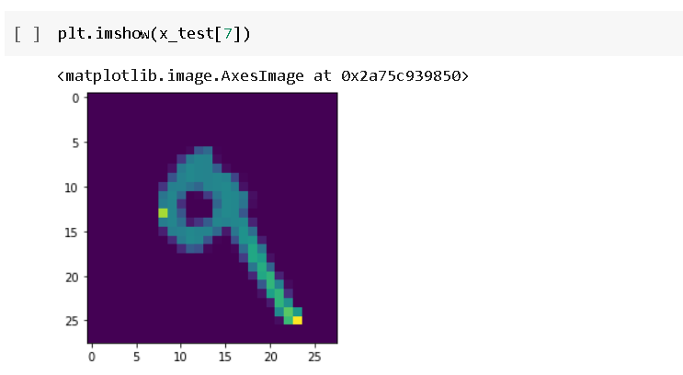

Slide 14
CNN Code usages
num = 0
i = i + 1
else:
m_exp[i] = str(item)
m_exp[i] = m_exp[i].replace("10","/")
m_exp[i] = m_exp[i].replace("11","+")
m_exp[i] = m_exp[i].replace("12","-")
m_exp[i] = m_exp[i].replace("13","*") i = i + 1
'joining the list of strings to create the mathematical expression' separator = ' '
m_exp_str = separator.join(m_exp)
return (m_exp_str)
'creating the mathematical expression'
m_exp_str = math_expression_generator(elements_pred) print(m_exp_str)
'calculating the mathematical expression using eval()'
while True: try:
answer = eval(m_exp_str) #evaluating the answer
answer = round(answer, 2)
equation = m_exp_str + " = " + str(answer) print(equation) #printing the equation
break
except SyntaxError:
print("Invalid predicted expression!!")
print("Following is the predicted expression:") print(m_exp_str)
break

Slide 15
Comparison Matrics

Slide 16
NUMBER PLATE RECOGNITION CODE
import matplotlib.pyplot as plt
import numpy as np
import cv2
import tensorflow as tf
from sklearn.metrics import f1_score
from tensorflow.keras import optimizers
from tensorflow.keras.models import Sequential
from tensorflow.keras.preprocessing.image import ImageDataGenerator
from tensorflow.keras.layers import Dense, Flatten, MaxPooling2D, Dropout, Conv2D
DATASET
import tensorflow.keras.backend as K train_datagen = ImageDataGenerator(rescale=1./255, width_shift_range=0.1, height_s path = '/content/drive/MyDrive/data' train_generator = train_datagen.flow_from_directory( path+'/train', # this is the target directory target_size=(28,28), # all images will be resized to 28x28 batch_size=1, class_mode='sparse') validation_generator = train_datagen.flow_from_directory( path+'/val', # this is the target directory
target_size=(28,28), class_mode='sparse') | # all images will be resized to 28x28 batch_size=1,

Slide 17
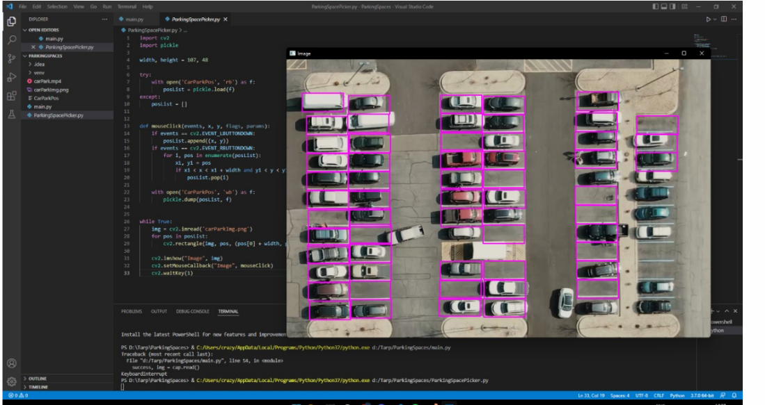
CAR SPACING

Slide 18
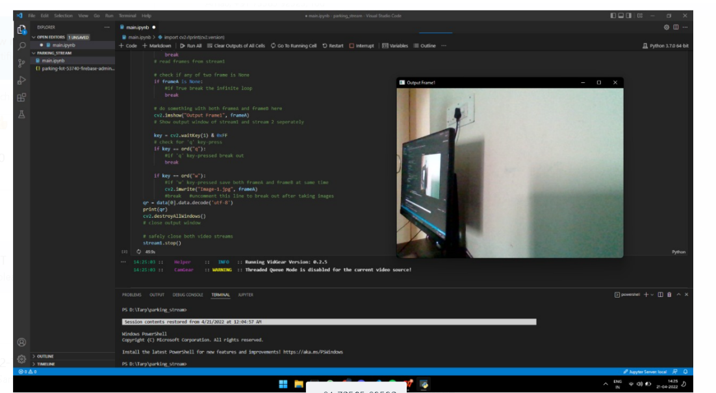
QR SACNNER OUTPUT SCREEN

Slide 19
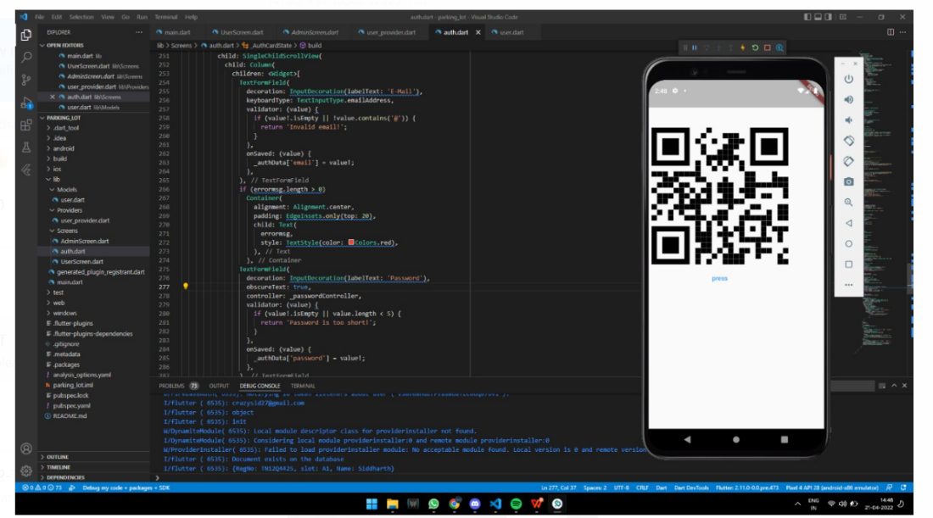

Slide 20
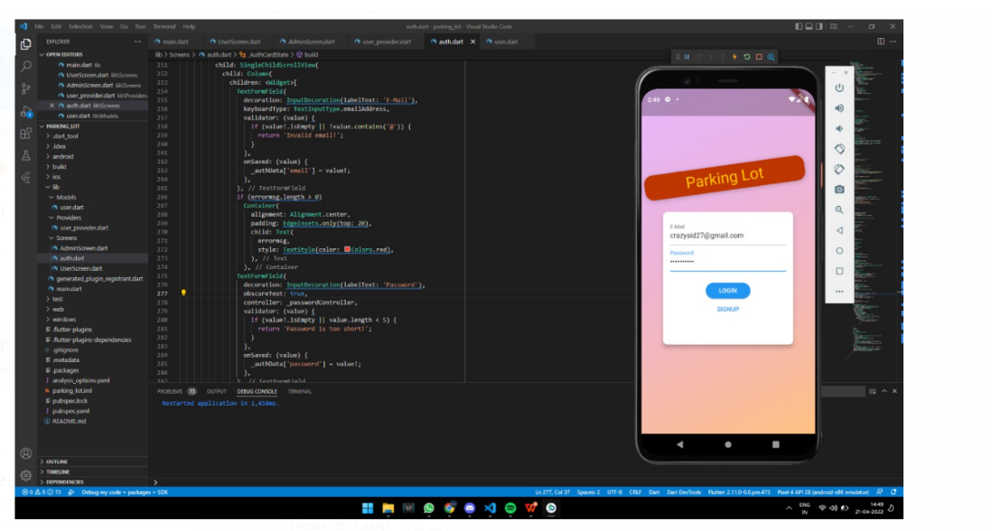
MOBILE APP

Slide 21
References
1: Barton, J., J. Buckley, B. O’Flynn, S.C. O’Mathuna and J.P. Benson et al., 2007. The D-systems project-wireless sensor
networks for car-park management. Proceedings of the 65th Vehicular Technology Conference, April 22-25, 2007,
VTC2007-Spring, pp: 170-173
CrossRef | Direct Link |
2: Benson, J.P., T. O'Donovan, P. O'Sullivan, U. Roedig and C. Sreenan et al., 2006. Car park management using wireless
sensor networks. Proceedings of the 31st Conference on Local Computer Networks, November 14-16, 2006, Tampa, FL., USA.,
pp: 588-595
CrossRef | Direct Link |
3: Bi, Y.Z., L.M. Sun, H.S. Zhu, T.X. Yan and Z.J. Luo, 2006. A parking management system based on wireless sensor network.
Acta Automatica Sin., 32: 877-968.
Direct Link |

Slide 22
R.S. Sinha, Y. Wei, S.H. Hwang
A survey on LPWA technology: LoRa and NB-IoT
ICT Express, 3 (1) (Mar. 01, 2017), pp. 14-21
Korean Institute of Communications Information Sciences
Y. Qian, et al.
Towards decentralized IoT security enhancement: a blockchain approach
Comput. Electr. Eng., 72 (Nov. 2018), pp. 266-273
K. Sha, T.A. Yang, W. Wei, S. Davari
A survey of edge computing-based designs for IoT security
Digit. Commun. Netw., 6 (2) (May 2020), pp. 195-202
M. Lee
An empirical study of home IoT services in South Korea: the moderating effect of the usage experience
Int. J. Hum. Comput. Interact., 35 (7) (Apr. 2019), pp. 535-547

Slide 23
Conclusion
Due to the rapid increase in urban population and unplanned urbanization, there is a decrement in the number of urban parking spaces and an increment in traffic congestion. As a result, smart parking becomes the subject of interest for both researchers and urban planners. This project provides a bird's eye view of smart parking systems deployed by different researchers. The systematically talks about different approaches taken by the researchers to develop their smart parking system and their suitability for different parking lots. The approaches for SPS have been classified into major groups, and an extensive comparison among the approaches has been provided to determine their strengths and weaknesses. The paper also provides information about different smart parking sensors and their usage for different conditions. Moreover, classification of SPS as per user interfaces, networking technologies, computational approaches, and services have been provided. These classifications provide a clear insight into SPSs from different angles and aspects. Besides, the study provides an elaborate discussion on the advantages and shortcomings of different types of SPSs in addressing various kinds of problems thrown at the systems.

